Slide 1
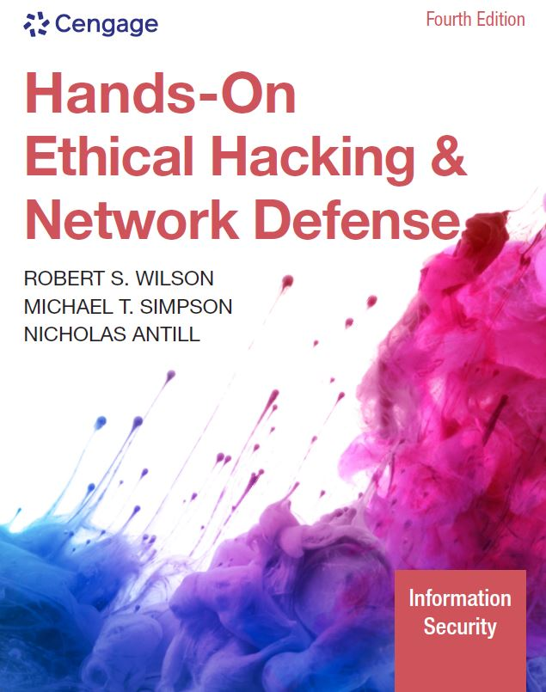
Hands-On Ethical Hacking and Network Defense, Edition 4
Module 7: Programming for Security Professionals
Simpson, Antill, Wilson, Hands-On Ethical Hacking and Network Defense, 4th Edition. © 2023 Cengage. All Rights Reserved. May not be scanned, copied or duplicated, or posted to a publicly accessible website, in whole or in part.

Slide 2
Module Objectives
By the end of this module, you should be able to:
Explain basic programming concepts
Write a simple C program
Explain how webpages are created with HTML
Describe and create basic Perl programs
Explain basic object-oriented programming concepts
Describe and create basic Python programs

Slide 3
Introduction to Computer Programming
Computer programmers:
Must understand rules of programming languages
Deal with syntax errors
One minor mistake and the program will not run
Or worse, it will produce unpredictable results
Being a good programmer takes time and patience

Slide 4
Programming Fundamentals
You can begin writing programs with little knowledge of programming fundamentals
Fundamental concepts
Acronym BLT
Branching
Looping
Testing

Slide 5
Branching, Looping, and Testing (BLT) (1 of 4)
Function
Mini program within a main program
Carries out a task
Branching
Takes you from one program area to another
Looping
Performing a task over and over
Completes after testing is conducted on a variable and returns a value of true or false
Testing
Verifies some condition
Returns a value of true or false

Slide 6
Branching, Looping, and Testing (BLT) (2 of 4)
#include <stdio.h>
main()
{
int a = 1 /* Variable initialized as an integer, value 1
if (a > 2) ; //Testing whether "a" is greater than 2
printf("a is greater than 2");
else
GetOut(); //* Branching: calling a different function
GetOut() // Do something interesting here
{
for(int a=1; a<11; a++) // Loop to display 10 times
{
printf("I'm in the GetOut() function");
}
}
}

Slide 7
Branching, Looping, and Testing (BLT) (3 of 4)
Algorithm
Defines the steps for performing a task
Keep it as simple as possible
Skipping a step can cause problems
Bug
An error that causes unpredictable results
Pseudocode
English-like language
Used to create the structure of your program

Slide 8
Branching, Looping, and Testing (BLT) (4 of 4)
Documenting your work is essential
Add comments to your code
Should explain what you are doing
Many programmers find it time-consuming and tedious
It helps others understand your work
Industry standard
10 bugs for every 1,000 lines of code
Windows 10 contains over 50 million lines of code
Fewer bugs than the average

Slide 9
Polling Activity 7-1
An algorithm is defined as which of the following?
A list of possible solutions for solving a problem
A method for automating a manual process
A program written in a high-level language
A set of instructions for solving a specific problem
Notes:
Instructions:
1. Use this activity to solicit student opinions about concepts in the module or to play a game.
2. Go to kahoot.com, or the platform of your preference, and log in or sign up.
3. Create the challenge.
4. Teacher Tip: Turn off the timer to prioritize accuracy or turn on the nickname generator to avoid inappropriate nicknames.
5. Invite players by sharing the link or PIN.
6. This can be done synchronously during class or asynchronously for review or homework.

Slide 10
Polling Activity 7-1: Answer
An algorithm is defined as which of the following?
Answer: d. A set of instructions for solving a specific problem
Algorithm, in computer lingo, refers to a set of steps to be followed for solving a specific problem.

Slide 11
Discussion Activity 7-1
What kind of error would a missing parenthesis or brace in a C compiler cause? Discuss the variety of syntax errors that can occur in programming languages.
Notes:
Instructions:
Use the Discussion activity to encourage group conversation about a related topic of interest.

Slide 12
Discussion Activity 7-1: Answer
What kind of error would a missing parenthesis or brace in a C compiler cause?
Answer: A missing parenthesis or brace in a C compiler will cause a syntax error.
A command’s syntax must be exact, right down to the placement of semicolons and parentheses. One minor mistake and the program won’t run correctly, or even worse, will produce unpredictable results.

Slide 13
Learning the C Language (1 of 3)
Developed by Dennis Ritchie
1972, Bell Laboratories
Powerful and concise language
UNIX
First written in assembly language
Later rewritten in C language
Assembly language uses a combination of hexadecimal numbers and expressions

Slide 14
Learning the C Language (2 of 3)
C++
An enhancement of C language
Compiler
Program that converts text-based program, called source code, into executable or binary code
Most C compilers can also create executable programs in C++

Slide 15
Learning the C Language (3 of 3)
Compiler | Description
Intel compilers for Windows and Linux | Intel’s C++ compiler is designed for developing applications for Windows servers, desktops, laptops, and mobile devices. The Intel Linux C++ compiler claims to optimize the speed of accessing information from a MySQL database, an open-source database program used by many corporations and e-commerce companies.
Microsoft Visual C++ Compiler | This compiler is widely used by programmers developing C and C++ applications for Windows platforms.
GNU C and C++ compilers (GCC) | These free compilers can be downloaded for Windows and *nix platforms. Most *nix systems include the GNU GCC compiler.

Slide 16
Anatomy of a C Program (1 of 3)
The first computer program a C student learns:
/* The famous "Hello, world!" C program */
#include <stdio.h>/* Load the standard IO library. The library contains functions your C program might need to call to perform various tasks. */
main()
{
printf("Hello, world!\n\n");
}

Slide 17
Anatomy of a C Program (2 of 3)
Many C programs use the /* and */ symbols to enclose long comments
Instead of // for one-line comments
#include statement
Loads libraries that hold commands and functions used in your program
Parentheses in C
Mean you are dealing with function
main() function
Required by every C program
Can also add your own functions to a C program

Slide 18
Anatomy of a C Program (3 of 3)
Braces
Show where a block of code begins and ends
Functions
When a function calls other functions, it uses parameters (known as arguments)
Parameters are placed between opening and closing parentheses
Character | Description
\n | New line
\t | Tab

Slide 19
Declaring Variables
Variable
Represents a numeric or string value
Can be declared at the beginning of a program
To ensure that calculations can be carried out without user intervention
Defined as a character or characters
Conversion specifiers
Tell the compiler how to convert the values in a function
Operators
Programmers use them to compare values, perform mathematical calculations, and the like
Mostly, programs you write will require calculating values based on mathematical operations

Slide 20
Variable Types in C
Variable type | Description
Int | Use this variable type for an integer (positive or negative number).
Float | This variable type is for a real number that includes a decimal point, such as 1.299999.
Double | Use this variable type for a double-precision floating-point number.
Char | This variable type holds the value of a single letter.
String | This variable type holds the value of multiple characters or words.
Const | A constant variable is created to hold a value that doesn’t change for the duration of your program. For example, you can create a constant variable called TAX and give it a specific value: const TAX =.085. If this variable is used in areas of the program that calculate total costs after adding an 8.5% tax, it’s easier to change the constant value to a different number if the tax rate changes, instead of changing every occurrence of 8.5% to 8.6%.

Slide 21
Conversion Specifiers in C
Specifier | Type
%c | Character
%d | Decimal number
%f | Floating decimal or double number
%s | Character string

Slide 22
Mathematical Operators in C
Operator | Description
+ (unary) | Doesn’t change the value of the number. Unary operators use a single argument; binary operators use two arguments. Example: +(2).
- (unary) | Returns the negative value of a single number.
++ (unary) | Increments the unary value by 1. For example, if a is equal to 5, ++a changes the value to 6.
— (unary) | Decrements the unary value by 1. For example, if a is equal to 5, —a changes the value to 4.
+ (binary) | Addition. For example, a + b.
- (binary) | Subtraction. For example, a – b.
* (binary) | Multiplication. For example, a * b.
/ (binary) | Division. For example, a / b.
% (binary) | Modulus. For example, 10 % 3 is equal to 1 because 10 divided by 3 leaves a remainder of 1.

Slide 23
Relational and Logical Operators in C
Operator | Description
== | Equal operator; compares the equality of two variables. In a == b, for example, the condition is true if variable a is equal to variable b.
! = | Not equal; the exclamation mark negates the equal sign. For example, the statement if a != b is read as “if a is not equal to b.”
> | Greater than.
< | Less than.
>= | Greater than or equal to.
<= | Less than or equal to.
&& | AND operator; evaluates as true if both sides of the operator are true. For example, if (( a > 5) && (b > 5)) printf ("Hello, world!"); prints only if both a and b are greater than 5.
| | | OR operator; evaluates as true if either side of the operator is true.
! | NOT operator; the statement ! (a == b), for example, evaluates as true if a isn’t equal to b.

Slide 24
Branching, Looping, and Testing in C (1 of 6)
Branching
main()
{
prompt(); //Call function to prompt user with a question
display(); //Call function to display graphics onscreen
calculate(); //Call function to do complicated math
cleanup(); //Call function to make all variables equal to
//zero

Slide 25
Branching, Looping, and Testing in C (2 of 6)
Branching (continued)
prompt()
{
[code for prompt() function goes here]
}
display()
{
[code for display() function goes here]
}
[and so forth]
}

Slide 26
Branching, Looping, and Testing in C (3 of 6)
While loop
main()
{
int counter = 1; //Initialize (assign a value to)
//the counter variable
while (counter <= 10) //Do what's in the brackets until false
{
printf("Counter is equal to %d\n", counter);
++counter; //Increment counter by 1;
}
}

Slide 27
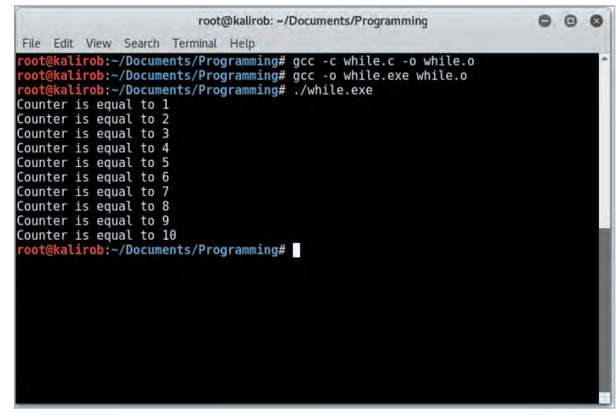
Branching, Looping, and Testing in C (4 of 6)
Source: Kali Linux
Figure 7-1 A while loop in action

Slide 28
Branching, Looping, and Testing in C (5 of 6)
do loop
main()
{
int counter = 1; //Initialize counter variable
do
{
printf("Counter is equal to %d\n", counter);
++counter; //Increment counter by 1
} while (counter <= 10); //Do what's in the brackets
// until false
}
for loop
for (counter = 1;counter <= 10;counter++)

Slide 29
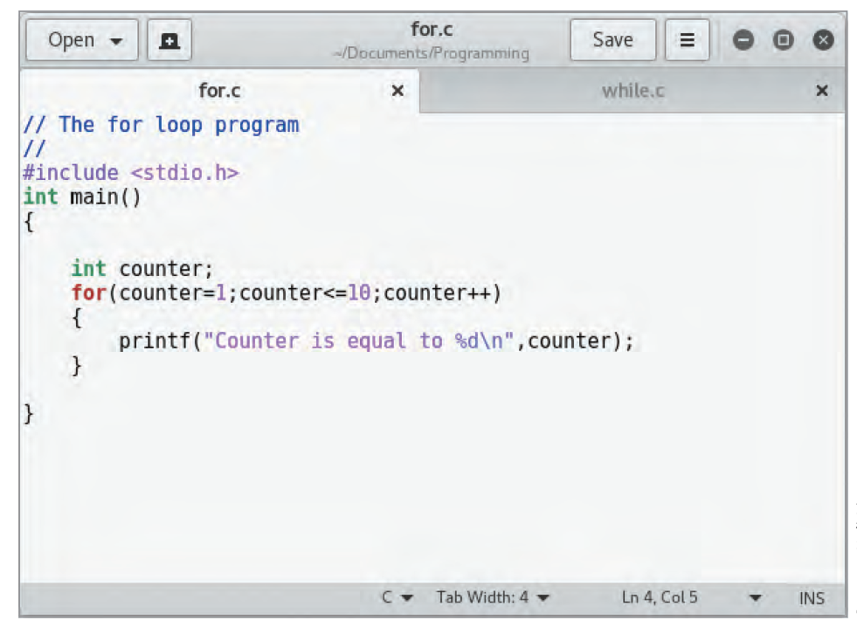
Branching, Looping, and Testing in C (6 of 6)
Source: Kali Linux
Figure 7-2 A for loop

Slide 30
Knowledge Check Activity 7-1
A C program must contain which of the following?
Name of the computer programmer
A main()function
The #include<std.h> header file
A description of the algorithm used
Notes:
Instructions:
Use the Knowledge Check questions to periodically pose a question to students during class to gauge how well they can recall the material that was presented.

Slide 31
Knowledge Check Activity 7-1: Answer
A C program must contain which of the following?
Answer: b. A main()function
C programs must contain a main()function.

Slide 32
Knowledge Check Activity 7-2
Which of the following C statements has the highest risk of creating an infinite loop?
while (a > 10)
while (a < 10)
for (a = 1; a < 100; ++a)
for (;;)
Notes:
Instructions:
Use the Knowledge Check questions to periodically pose a question to students during class to gauge how well they can recall the material that was presented.

Slide 33
Knowledge Check Activity 7-2: Answer
Which of the following C statements has the highest risk of creating an infinite loop?
Answer: d. for (;;)
The code for (;;)is powerful, yet dangerous, implementation of the for loop. The for (;;) statement tells the compiler to keep doing what’s in the brackets over and over and over creating an infinite loop.

Slide 34
Understanding HTML Basics
HTML
Markup language
Used mainly for webpage formatting and layout
Basic HTML syntax is the basis for web development
Security professionals often need to:
Examine webpages
Recognize when something looks suspicious

Slide 35
Creating a Webpage with HTML
You can create an HTML webpage in Notepad
View it in a web browser
HTML
Does not use branching, looping, or testing
The < and > symbols
Denote HTML tags
Each tag has a matching closing tag that includes a forward slash
<HTML> and </HTML>

Slide 36
HTML Formatting Tags
Opening tag | Closing tag | Description
<h1>, <h2>, <h3>, <h4>, <h5>, and <h6> | <h1>, <h2>, <h3>, </h4>, </ h5>, and </h6> | Formats text as different heading levels. Level 1 is the largest font size, and level 6 is the smallest.
<p> | </p> | Marks the beginning and end of a paragraph.
<b> | </b> | Formats enclosed text in bold.
<i> | </i> | Formats enclosed text in italics.

Slide 37
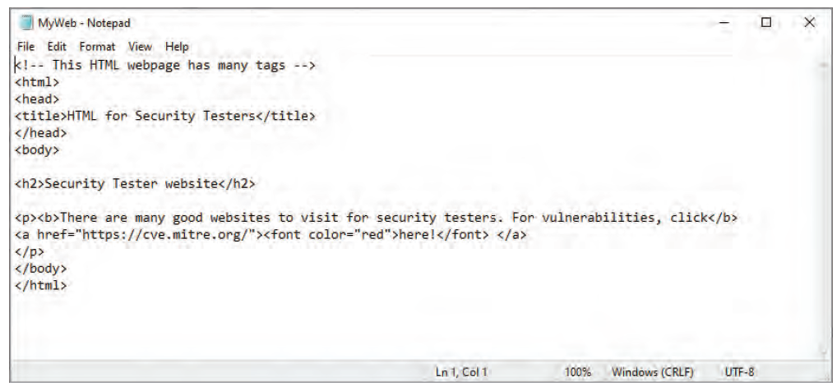
Creating a Webpage with HTML (1 of 2)
Source: Microsoft Windows Notepad
Figure 7-4 HTML source code

Slide 38
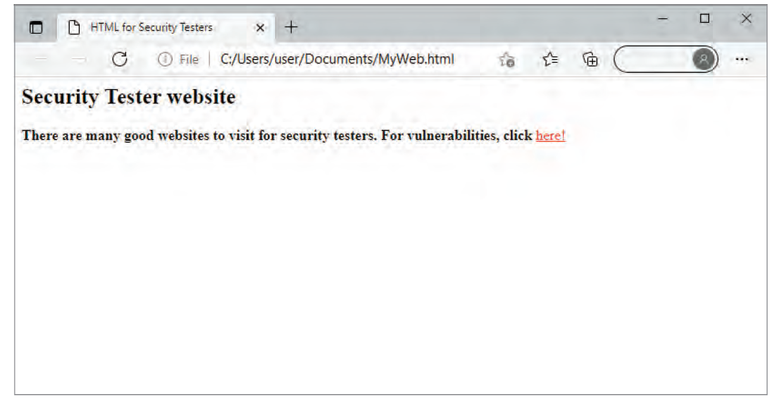
Creating a Webpage with HTML (2 of 2)
Source: Microsoft Windows
Figure 7-5 HTML webpage

Slide 39
Understanding Perl
Practical Extraction and Report Language (Perl)
Used to write scripts and programs for security professionals
Powerful scripting language
Perl and Python are two very popular languages for security professionals

Slide 40
Background on Perl
Developed by Larry Wall in 1987
Can run on almost any platform
*nix-based OSs already have Perl installed
Perl syntax is similar to C
Hackers use Perl to create automated exploits and malicious bots
Security professionals use Perl to perform repetitive tasks and conduct security monitoring

Slide 41
Understanding the Basics of Perl (1 of 3)
The perl –h command
Gives a list of parameters used with perl command
Perl has a printf command for formatting complex variables

Slide 42
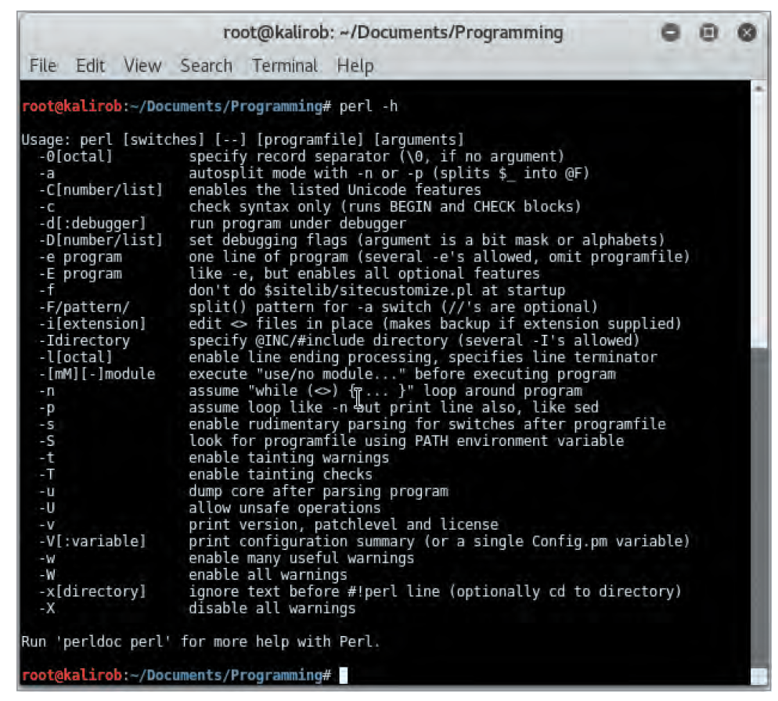
Understanding the Basics of Perl (2 of 3)
Source: Kali Linux
Figure 7-8 Using the perl –h command

Slide 43
Understanding the Basics of Perl (3 of 3)
Formatting character | Description | Input | Output
%c | Character | printf ‘%c’ , "d" | d
%s | String | printf ‘%s’, "This is fun!" | This is fun!
%d | Signed integer in decimal | printf ‘%+d%d’, 1, 1 | +1 1
%u | Unsigned integer in decimal | printf ‘%u’, 2 | 2
%o | Unsigned integer in octal | printf ‘%o’ , 8 | 10
%x | Unsigned integer in hexadecimal | printf ‘%x’, 10 | a
%e | Floating-point number in scientific notation | printf ‘%e’ , 10; | 1.000000e+001 (depending on the OS)
%f | Floating-point number in fixed decimal notation | printf ‘%f’ , 1; | 1.000000

Slide 44
Understanding the BLT of Perl
Some syntax rules to keep in mind:
The sub keyword is used before function names
Variables begin with the $ symbol
Comment lines begin with the # symbol
The & symbol indicates a function
Except for these minor differences, Perl’s syntax is much like the C syntax

Slide 45
Branching in Perl
To go from one function to another, you call the function by entering its name in your source code
# Perl program illustrating the branching function
# Documentation is important
# Initialize variables
$first_name = "Jimi";
$last_name = "Hendrix";
&name_best_guitarist;
sub name_best_guitarist
{
printf "%s %s %s", $first_name, $last_name, "was the best!";
}

Slide 46
Looping in Perl
for loop
for ($a = 1; $a <= 10; $a++)
{
print "Hello security testers!\n"
}
while loop
$a = 1;
while ($a <=10)
{
print "Hello security testers!\n";
$a++
}

Slide 47
Testing Conditions in Perl (1 of 3)
Most programs must be able to test the value of a variable or condition
The two looping examples shown previously use the less than or equal to operator (<=)
Other operators used for testing in Perl are similar to C operators
Often you combine these operators with Perl conditionals, such as the following:
if—Checks whether a condition is true
if (($age < 12) {
print "You must be a know-it-all!";
}

Slide 48
Testing Conditions in Perl (2 of 3)
else—Used when there are several conditionals to test
elsif ($age > 39)
{
print "You must lie about your age!";
}
else
{
print "To be young...";
}

Slide 49
Testing Conditions in Perl (3 of 3)
unless—Executes unless the condition is true
unless ($age == 100)
{
print "Still enough time to get a bachelor's degree.";
}

Slide 50
Perl Operators (1 of 3)
Operator | Function | Example
+ | Addition | $total = $sal + $commission
– | Subtraction | $profit = $gross sales – $cost of goods
* | Multiplication | $total = $cost * $quantity
/ | Division | $GPA = $total_points / $number of classes
% | Modulus | $a % 10 = 1
** | Exponent | $total = $a**10

Slide 51
Perl Operators (2 of 3)
Assignments | Function | Example
= | Assignment | $Last name = "Rivera"
+= | Add, then assignment | $a+ = 10; shorthand for $a=$a+10
-= | Subtract, then assignment | $a–=10; shorthand for $a=$a–10
*= | Multiply, then assignment | $a* = 10; shorthand for $a=$a*10
/= | Divide, then assignment | $a/ = 10; shorthand for $a=$a/10
%= | Modulus, then assignment | $a%=10; shorthand for $a=$a%10
**= | Exponent and assignment | $a**=2; shorthand for $a=$a**2
++ | Increment | $a++; increment $a by 1
— | Decrement | $a––; decrement $a by 1

Slide 52
Perl Operators (3 of 3)
Comparisons | Function | Example
== | Equal to | $a==1; compare value of $a with 1
!= | Not equal to | $a!=1; $a is not equal to 1
> | Greater than | $a>10
< | Less than | $a<10
>= | Greater than or equal to | $a<10
<= | Less than or equal to | $a<10

Slide 53
Understanding Object-Oriented Programming Concepts
Technology
Changes frequently
Object-oriented programming
Isn’t new to experienced programmers
Might not be familiar to those just learning how to write their first Perl script
Takes time and practice to learn

Slide 54
Components of Object-Oriented Programming (1 of 2)
Classes
Structures that hold pieces of data and functions
The :: symbol
Used to separate the name of a class from a member function
Example: To access a member function, you use the class name followed by two colons and the member function’s name:
Employee::GetEmp()

Slide 55
Components of Object-Oriented Programming (2 of 2)
// This is a class called Employee created in C++
class Employee
{
public:
char firstname[25];
char lastname[25];
char PlaceOfBirth[30];
[code continues]
};
void GetEmp()
{
// Perform tasks to get employee info
[program code goes here]
}

Slide 56
Win32 API Functions (1 of 3)
Function | Description
GetLastError() | Returns the last error generated when a call was made to the Win32 API.
OLELastError() | Returns the last error generated by the object linking and embedding (OLE) API.
BuildNumber() | Returns the Perl build number.
LoginName() | Returns the username of the person running Perl.
NodeName() | Returns the NetBIOS computer name.
DomainName() | Returns the name of the domain the computer is a member of.
FsType() | Returns the name of the file system, such as NTFS or FAT.
GetCwd() | Returns the current active drive.
SetCwd(newdir) | Enables you to change to the drive designated by the newdir variable.
GetOSName() | Returns the OS name.
FormatMessage(error) | Converts the error message number into a descriptive string.

Slide 57
Win32 API Functions (2 of 3)
Function | Description
Spawn(command, args, $pid) | Starts a new process, using arguments supplied by the programmer and the process ID ($pid).
LookupAccountSID(sys, sid, $acct, $domain, $type) | Returns the account name, domain name, and security ID (SID) type.
InitiateSystemShutdown(machine, message, timeout, forceclose, reboot) | Shuts down a specified computer or server.
AbortSystemShutdown(machine) | Aborts the shutdown if it was done in error.
GetTickCount() | Returns the Win32 tick count (time elapsed since the system first started).
ExpandEnvironmentalStrings (envstring) | Returns the environmental variable strings specified in the envstring variable.
GetShortPathName(longpathname) | Returns the 8.3 version of the long pathname. In DOS and older Windows programs, filenames could be only eight characters, with a three-character extension.

Slide 58
Win32 API Functions (3 of 3)
Function | Description
GetNextAvailableDrive() | Returns the next available drive letter.
RegisterServer(libraryname) | Loads the DLL specified by libraryname and calls the DLLRegisterServer() function.
UnregisterServer(libraryname) | Loads the DLL specified by libraryname and calls the DLLUnregisterServer() function.
Sleep(time) | Pauses the number of milliseconds specified by the time variable.

Slide 59
Polling Activity 7-2
Which of the following is the Win32 API function for verifying the file system on a Windows computer?
Filesystem()
FsType()
System()
IsNT()
Notes:
Instructions:
1. Use this activity to solicit student opinions about concepts in the module or to play a game.
2. Go to kahoot.com, or the platform of your preference, and log in or sign up.
3. Create the challenge.
4. Teacher Tip: Turn off the timer to prioritize accuracy or turn on the nickname generator to avoid inappropriate nicknames.
5. Invite players by sharing the link or PIN.
6. This can be done synchronously during class or asynchronously for review or homework.

Slide 60
Polling Activity 7-2: Answer
Which of the following is the Win32 API function for verifying the file system on a Windows computer?
Answer: b. FsType()
FsType()is a Win32 API function that returns the name of the file system on a Windows computer.

Slide 61
Python
Scripting language with some object-oriented features
Emphasizes code readability and uses indentation to define blocks of code
Background
Guido van Rossum conceived of Python in the late 1980s
Python’s principal author
Continuing central figure in decisions regarding the direction of Python’s development
Runs on almost any platform (including Windows), and *nix-based OSs usually have Python already installed

Slide 62
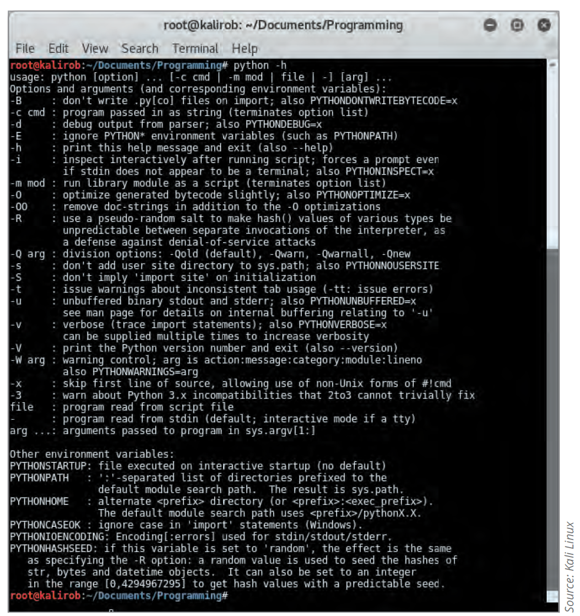
Understanding the Basics of Python
Knowing how to get help quickly in any programming language is useful.
The python -h command lists parameters used with the python command

Slide 63
Understanding the BLT of Python (1 of 4)
Syntax rules to keep in mind:
Spacing is important
When creating a function, insert the def keyword in front of the function’s name
Variables do not begin with any special symbol
There are no special characters at the end of lines of code
Comment lines begin with the # symbol
Branching
To go from one function to another in a Python program, you call the function by entering its name followed by parentheses

Slide 64
Understanding the BLT of Python (2 of 4)
The name_best_guitarist() line branches the program to the name_best_guitarist() function in the following Python program:
# Python program illustrating the branching function
# Documentation is important
# Initialize variables
first_name = "Jimi "
last_name = "Hendrix"

Slide 65
Understanding the BLT of Python (3 of 4)
(continued)
# define the name_best_guitarist function
# a function must be defined before it can be called
def name_best_guitarist():
print(first_name + last_name + " was the best!")
name_best_guitarist()

Slide 66
Understanding the BLT of Python (4 of 4)
Looping in Python
The Python for loop repeats until it has gone through each item specified in a list of items
names = ["Bob", "Jamal", "Sasha"]
for x in names:
print(x)
The while loop repeats a set of code lines as long as a test condition remains true
Do not need brackets in a while loop
i = 1
while i < 6:
print(i)
i += 1

Slide 67
Python Operators (1 of 2)
Operator | Function | Example
+ | Addition | total = sal + commission
– | Subtraction | profit = grossSales – costOfGoods
* | Multiplication | total = cost * quantity
/ | Division | GPA = totalPoints / numberOfClasses
% | Modulus | x = a % 2
** | Exponent | area = 3.14 * (r**2)
Assignments | Function | Example
= | Assignment | lastName = "Rivera"
+= | Add, then assignment | a+ = 10 #shorthand for a=a+10
-= | Subtract, then assignment | a–=10 #shorthand for a=a–10
*= | Multiply, then assignment | a* = 10 #shorthand for a=a* 10

Slide 68
Python Operators (2 of 2)
Operator | Function | Example
/= | Divide, then assignment | a/ = 10 #shorthand for a=a/10
%= | Modulus, then assignment | a%=10 #shorthand for a=a%10
**= | Exponent and assignment | a**=2 #shorthand for a=a**2
++ | Increment | GPA = totalPoints / numberOfClasses
% | Modulus | a++ #increment a by 1
— | Decrement | a–– #decrement a by 1
Comparisons | Function | Example
== | Equal to | a== 1 #compare value of a with 1
!= | Not equal to | a!=1 #a is not equal to 1
> | Greater than | a>10
< | Less than | a<10
>= | Greater than or equal to | a>=10
<= | Less than or equal to | a<=10

Slide 69
If Statements and Logical Operators (1 of 3)
“If statement” combines logical operators with variables and numbers to create conditional checks
You can combine an "if statement" with the keywords else and elseif
if—Checks whether a condition is true
if (age < 12)
print("You must be a know-it-all!")
else—Used when there’s only one option to carry out if the condition is not true
if (age > 12)
print("You must be a know-it-all!")
else
print("Sorry, but I don’t know why the sky is blue.")

Slide 70
If Statements and Logical Operators (2 of 3)
elif—Used when there are several conditionals to test
if ( (age > 12) && (age < 20) )
print("You must be a know-it-all!")
elif (age > 39)
print("You must lie about your age!")
else:
print("To be young...")

Slide 71
If Statements and Logical Operators (3 of 3)
Nested ifs: When you can include if statements inside other if statements
y = 69
if y > 10:
print("Greater than ten")
if y > 20:
print("Also greater than 20!")
else:
print("But not greater than 20")

Slide 72
Python Shell (R E P L)
An interactive shell where you can enter Python commands and have them immediately executed
Known as the R E P L
Stands for Read, Evaluate, Print, Loop
Reads a command, evaluates the command, prints the results, and loops back to read more commands
You can enter the shell by typing python and pressing Enter in a terminal or command window

Slide 73
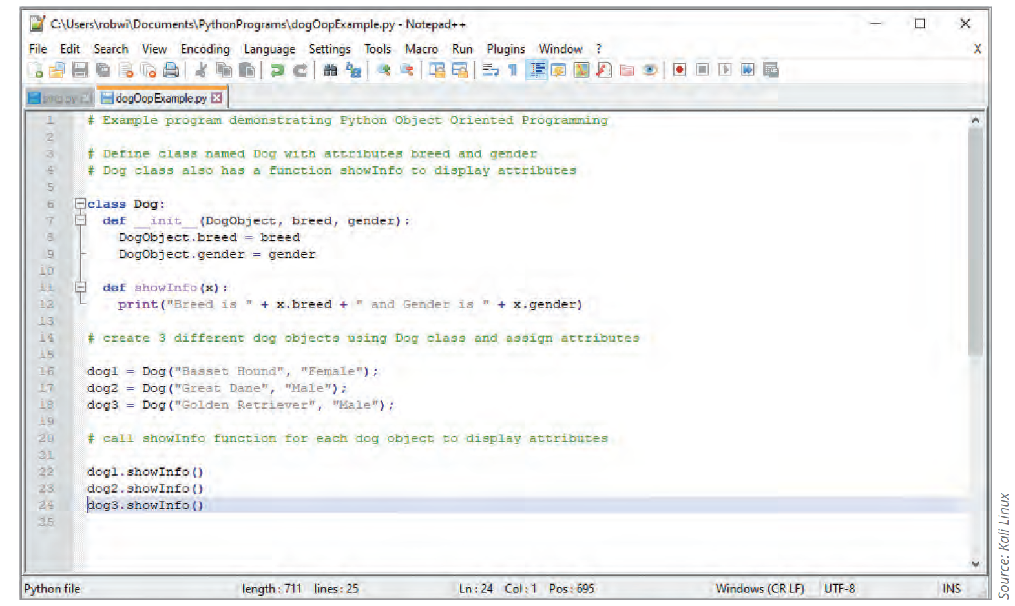
Object-Oriented Programming in Python
Python supports traditional OOP concepts such as classes, objects, and inheritance

Slide 74
An Overview of Ruby (1 of 3)
Ruby
An object-oriented language used by many security testers
Similar to Perl
Metasploit
A Ruby-based program used by security testers
To check for vulnerabilities on computer systems
Security testers should understand the basics of Ruby
Be able to modify Ruby code

Slide 75
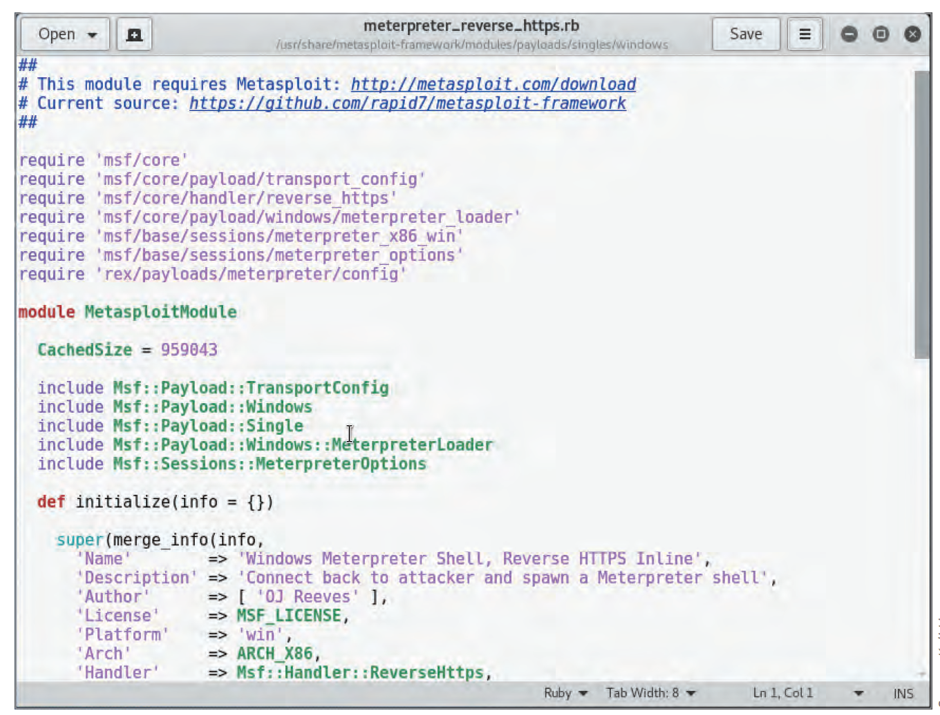
An Overview of Ruby (2 of 3)
Source: Kali Linux
Figure 7-23 Modifying reverse shell payload code in Ruby

Slide 76
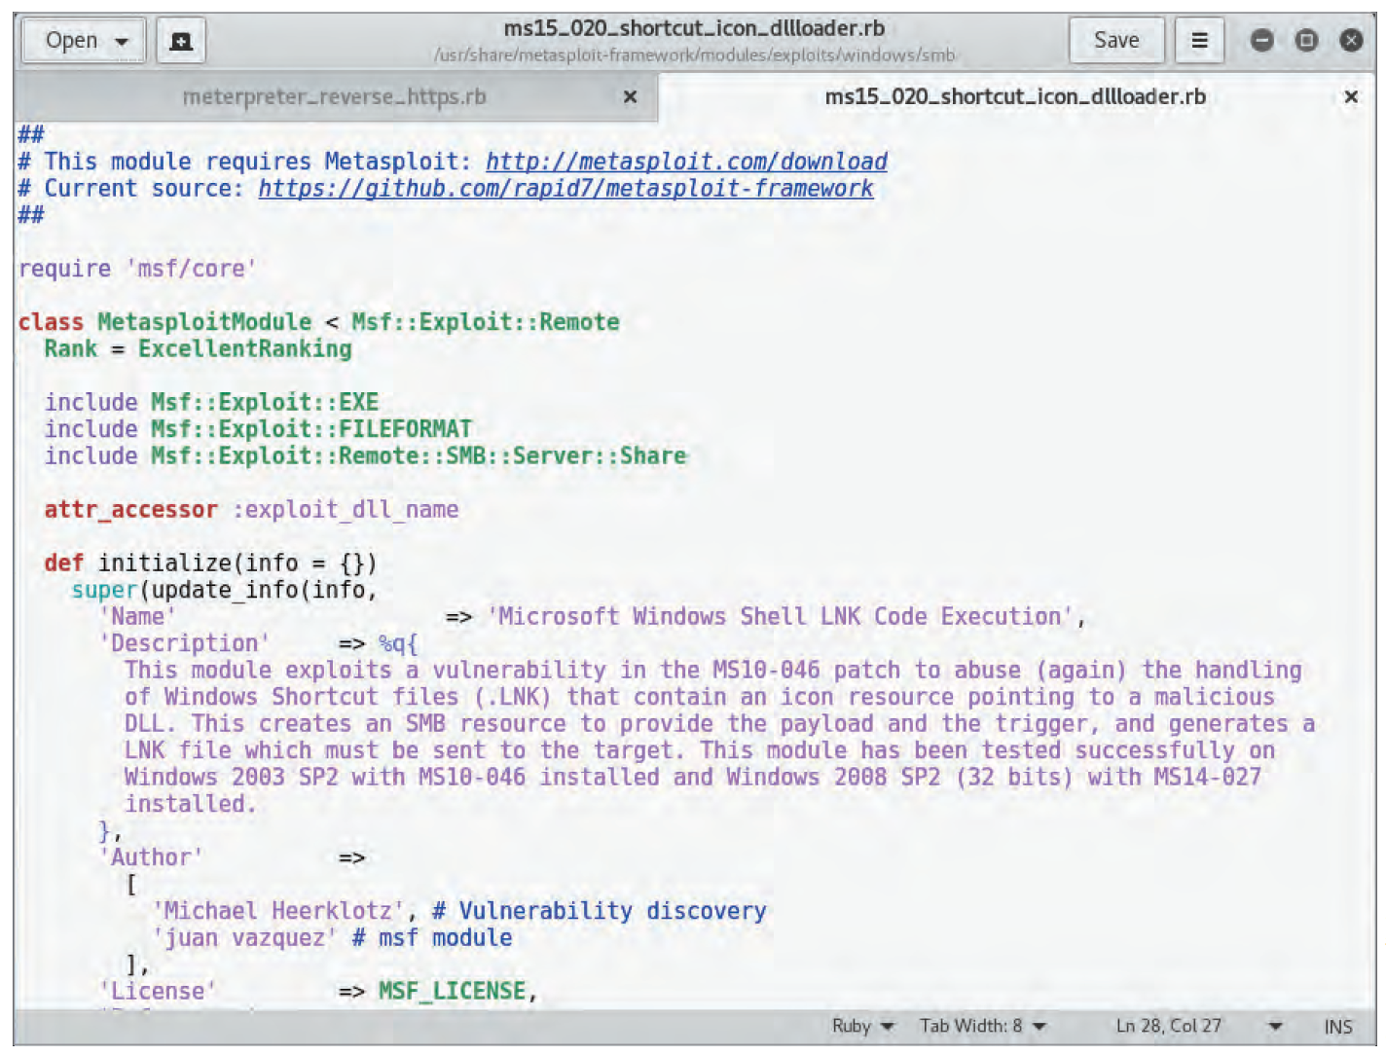
An Overview of Ruby (3 of 3)
Source: Kali Linux
Figure 7-25 Examining the code of a Metasploit module written in Ruby

Slide 77
Self-Assessment
Describe the four types of programming languages and their features.
Notes:
Instructions:
Use the Self-Assessment question to encourage students to evaluate their progress or goals in the course, as well as determine how they might apply their learning or grow as an individual.

Slide 78
Summary
Now that the lesson has ended, you should be able to:
Explain basic programming concepts
Write a simple C program
Explain how webpages are created with HTML
Describe and create basic Perl programs
Explain basic object-oriented programming concepts
Describe and create basic Python programs

